Slide 1
C Code Comprehension
Name: A. M Samdani Mozumder
Roll: BSSE 1412
Supervisor Name: Dr. Kazi Muheymin-Us-Sakib

Slide 2
Table of Contents
01. Project Description
02. Motivation
03. Working Methodology
04. Technology
05. Progress
06. Further Plan
07. Challenges

Slide 3
Project Description
1

Slide 4
Project Description
This Software tool is designed for underdstanding C source code specially for beginners. This will take a C source code from the user. Then it will interpret line by line of the source code.
It will also help the user to find some common errors of the source code.

Slide 5
Motivation
2

Slide 6
Motivation
Static analysis is widely used in software engineering by software development and quality assurance teams. Software developers should use static code analysis for a better understanding of the software, code simplification and sanitizing, identifying potential bugs, coding standards, improving application performance, better resource utilization, etc.

Slide 7
Working Methodology
3

Slide 8
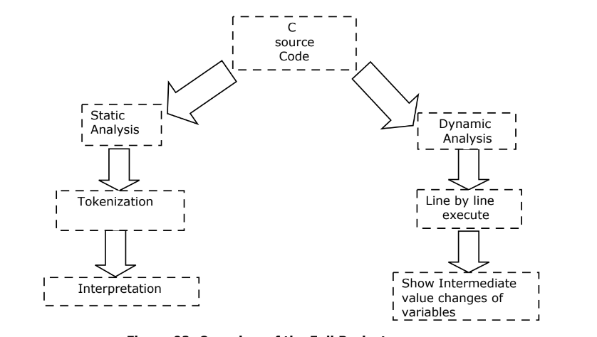
Working Methodology
Overview of Full Process

Slide 9
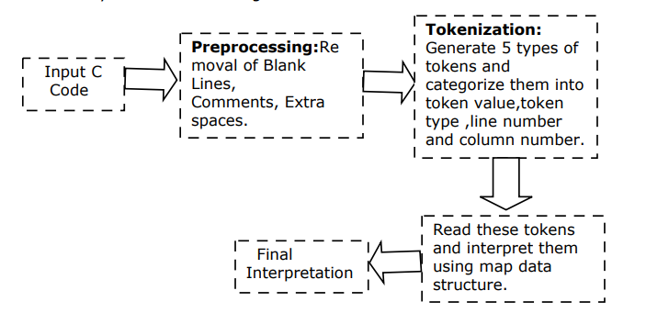
Working Methodology
Interpretation

Slide 10
Working Methodology
Dynamic Analysis

Slide 11
Technology
4

Slide 12
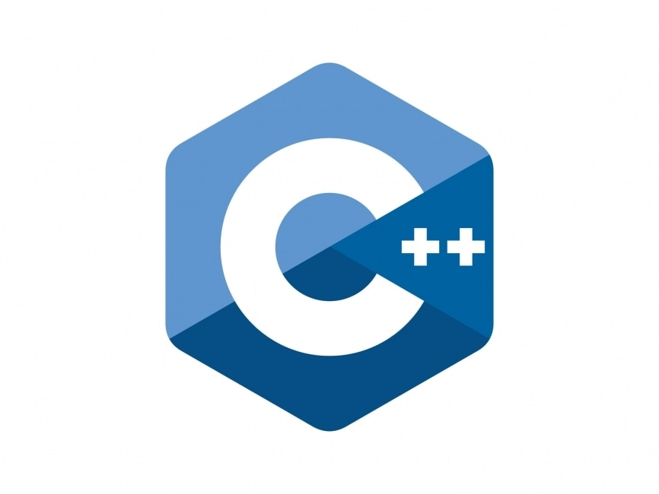
Technology

Slide 13
Results
5

Slide 14
Result
Static Analysis
Reading Headers
Reading Main Function
Reading Variable Type
Reading Variable Value
Reading If statement
Reading Single Condition inside if
Reading Condition is either true or not
Reading For loop and its three parts
Variable Declaration
Condition
Modification
Reading While loop
Reading Printf Statement
Tokenization
Reading Array declaration
Array input and output using loop
Reading String declaration
String input and output using loop
Reading pointer declaration
Reading String Library Functions
Reading two variable basic arithmetic expression
Line Of Code
1679

Slide 15
Result
Dynamic Analysis
Executing Each line
Get the intermediate value of variables
Write them in a output file
Error
Semi-color error
Ampersand(&) error in scanf

Slide 16
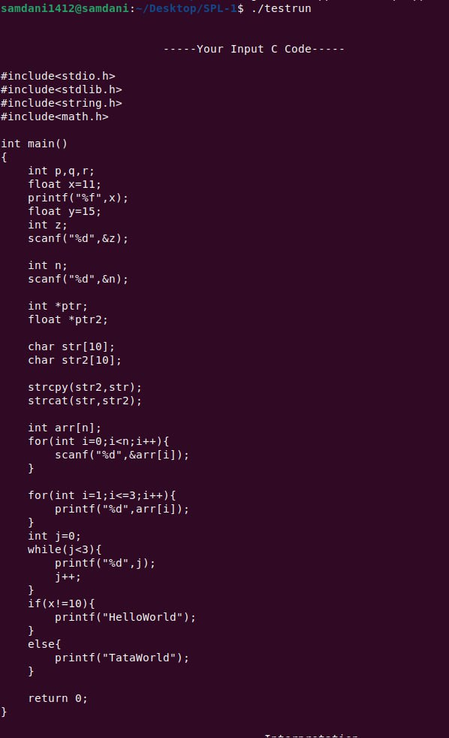
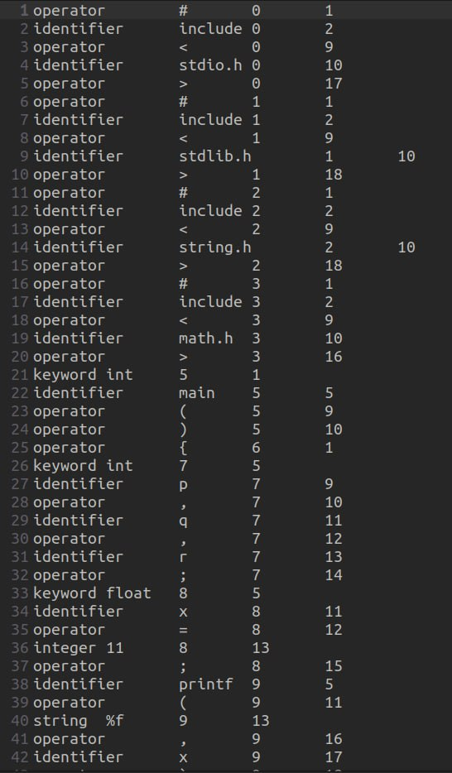
Tokenization

Slide 17
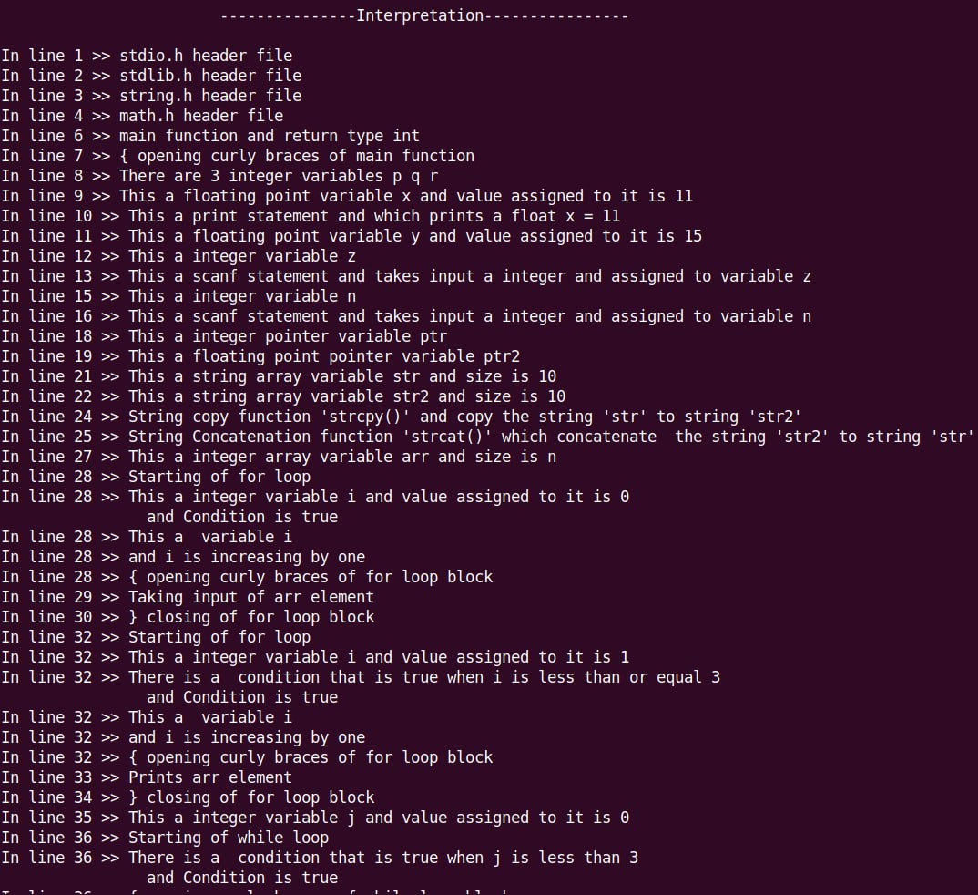

Slide 18
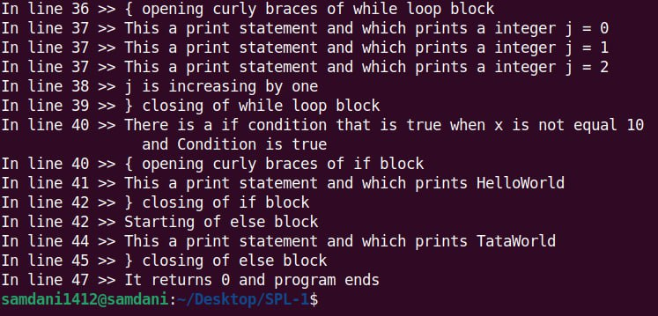

Slide 19
Dynamic Analysis

Slide 20
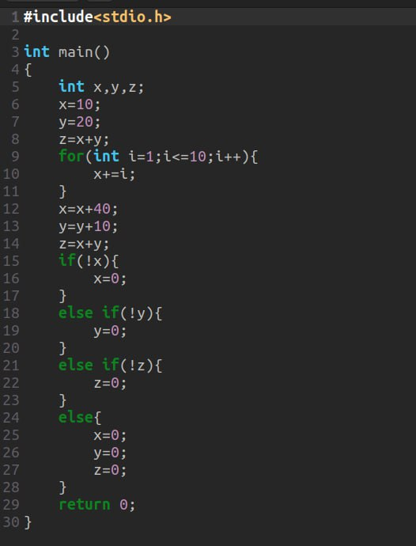
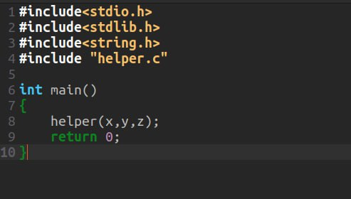
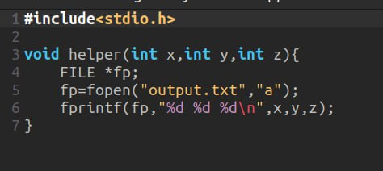

Slide 21
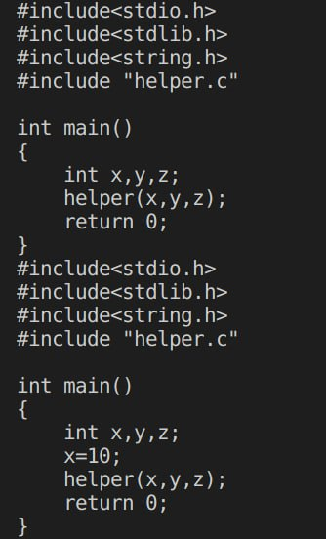
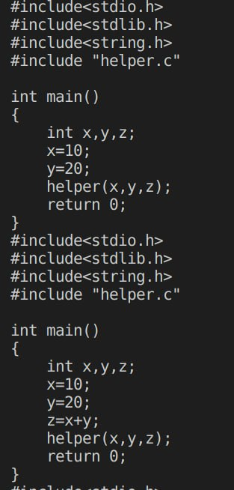
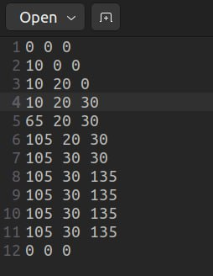

Slide 22
Error Checking

Slide 23
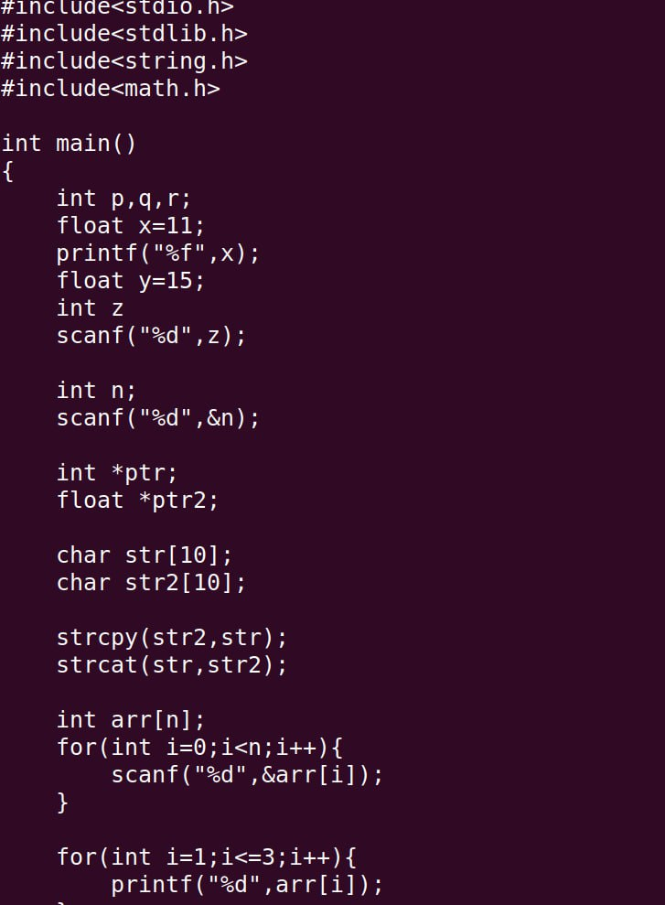
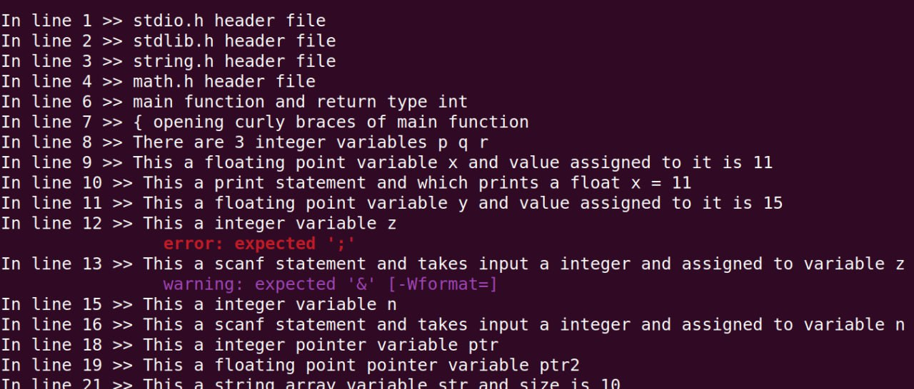

Slide 24
Challenges
6

Slide 25
Challenges
Challenges so far:
First time working on a big project
Learning C++ deeply
Tokenization of source code (Lexical Analysis)
File Manipulation and implementing Map Data structure
Learning about Dynamic Analysis and its implemention on interpretation

Slide 26
Thank You
GitHub repository: https://github.com/samdani91/SPL-1

